Slide 1

Workplace Module Project- Lucent Ngwenya
Data Science (PT)

Slide 2
Table Of Contents
Introduction
Data Tools Used
Data Clean Up
Model Evaluation
Findings and Conclusion

Slide 3
Introduction
Problem Statement
Agriculture is critical to India’s economy but suffers from fragmented, inaccessible data.
Lack of unified data limits informed decisions for farmers, policymakers, and researchers.
Goal
Create a platform to visualize and integrate state and district-level agricultural data.
Provide insights on crop production, yields, and cultivated areas.
Highlight patterns, gaps, and regional disparities.
Impact
Help farmers choose better crops.
Enable targeted policy interventions.
Support research on agricultural trends.

Slide 4
Data Tools
1. Jupyter Notebook
Interactive environment for coding and data analysis.
Developed Python scripts for data cleaning and transformation.
Created visualizations and exploratory analysis.
Documented workflows for reproducibility.
2. Excel
Spreadsheet tool for quick data manipulation and summaries.
Performed initial data validation and formatting.
Generated pivot tables and charts for preliminary insights.
Used for manual checks and reporting.
3. GitHub
Version control and collaboration platform.
Stored and managed code repositories.
Enabled team collaboration and code reviews.
Maintained version history for transparency.
4. Python
Core programming language for data processing and visualization.
Automated data integration from multiple sources.
Built visualization dashboards using libraries like Matplotlib, Seaborn, and Plotly.
Implemented scripts for pattern detection and trend analysis.

Slide 5
Data Clean Up
The following process was followed to clean up the data
Loaded the dataset into a DataFrame
Display the first few rows for a quick overview
Check column names for consistency
Ensured correct data types across columns
Handled missing values by replacing NaNs with column means
Removed duplicate records
Filtered data based on relevant conditions

Slide 6
Model Evaluation
Purpose: Assess accuracy and effectiveness of predictive models for crop production forecasting.
Key Metrics:
R² Score – Variance explained by the model.
RMSE – Magnitude of prediction error.
(For classification: Accuracy, Precision, Recall, F1-score.)
Model Performance:
Linear Regression: R² ≈ 0.65, higher error.
Random Forest: R² ≈ 0.85, lower error.
Interpretation: Random Forest is more accurate and preferred.
Summary:
Random Forest demonstrates superior performance and robustness.
Models generalize well to unseen data.
Future Improvements: Incorporate additional features (e.g., rainfall, soil type).Apply cross-validation for improved reliability.

Slide 7
Model Evaluation
Interpretation
Random Forest effectively captures complex non-linear relationships and variable interactions.
Rice Area emerges as the most significant predictor in the model.
Residuals from Random Forest are more uniformly distributed, indicating a better overall fit compared to other models.
Feature​ | Importance​
Rice Area​ | 0.44​
Wheat Area​ | 0.36
Maize Area​ | 0.188​

Slide 8
Model Evaluation
Random Forest Summary Overview:
Combines multiple decision trees to improve accuracy and reduce overfitting in regression tasks.
Implementation: Imported, instantiated, trained on data, and used for predictions.
Application: Predicts agricultural yield by effectively capturing complex relationships in input data.
Future Enhancements: Hyperparameter tuning, cross-validation, and feature engineering for better performance.

Slide 9
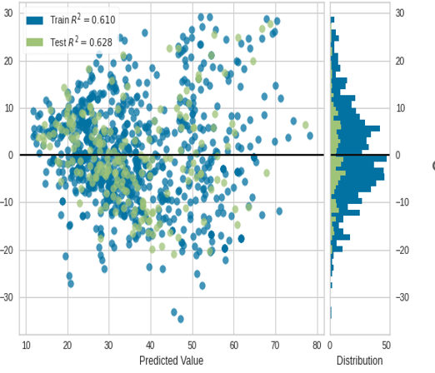
Model Evaluation
Residual Plot Summary
Visualizes differences between actual and predicted values to assess regression model performance.
Even distribution of residuals around zero indicates no bias and a good model fit (Random Forest performs well).
Helps detect outliers and problematic areas for model refinement.
Regular monitoring ensures sustained accuracy as data and conditions change.

Slide 10
Recommendations
Prioritise Rice Cultivation : Increase the area under rice cultivation to improve predictive accuracy, as this remains the most influential factor in yield forecasting.
Monitor Wheat and Maize : Maintain close observation of wheat and maize cultivation areas, given their significant contribution to overall yield predictions.
Continue Using Random Forest Model : Retain the Random Forest approach due to its robustness, ability to capture non-linear relationships, and well-distributed residuals indicating a good fit.
Explore Feature Engineering : Investigate new predictors and transform existing features to enhance model generalisation and performance.
Incorporate Additional Data Sources : Integrate variables such as rainfall, soil type, and weather conditions to enrich the dataset and improve model accuracy.
Apply Hyperparameter Tuning : Optimise Random Forest parameters to achieve better predictive outcomes.
Implement Cross-Validation : Use cross-validation techniques to ensure reliability and reduce overfitting.
Develop Interactive Dashboards : Create user-friendly visualisation tools for stakeholders to access insights and make informed decisions.
Regular Model Monitoring :Continuously monitor residual plots and performance metrics to maintain accuracy as new data becomes available.
Plan for Scalability : Design the system to accommodate larger datasets and enable integration with real-time data streams for future expansion.

Slide 11

Findings & Conclusion
Summary of Findings
The Random Forest model exhibited strong predictive capability, with residuals evenly distributed around zero, indicating minimal bias and good generalisation.
Feature importance analysis confirmed that Rice Area is the most influential predictor, followed by Wheat Area and Maize Area, underscoring the significance of crop-specific data in yield forecasting.
Insights Gained
Accurate measurement of rice cultivation areas has the greatest impact on prediction accuracy.
Wheat and maize areas provide secondary yet meaningful contributions.
Random Forest’s robustness makes it highly suitable for agricultural yield prediction tasks.
Limitations
The dataset lacks granularity in environmental factors such as soil quality and rainfall.
Limited temporal data restricts the ability to capture seasonal variations.
Model interpretability remains a challenge compared to simpler algorithms.
Future Considerations
Data Enrichment: Incorporate weather, soil, and irrigation data for improved accuracy.
Model Optimisation: Apply hyperparameter tuning and explore ensemble approaches.
Feature Engineering: Develop derived features such as crop rotation patterns.
Monitoring & Maintenance: Implement model drift detection and schedule periodic retraining.
Scalability: Extend the methodology to additional crops and regions for broader applicability.

